Slide 1
Wellbeing

Slide 4
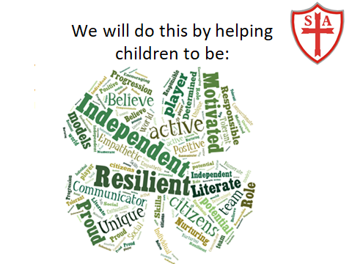

Slide 6
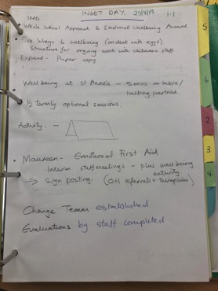
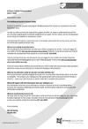
Objective 1
The school is committed to promoting and protecting emotional wellbeing and mental health by achieving the Wellbeing Award for Schools.
1.1 The award process is reviewed by the SLT and governors
and formally adopted.
Governors were made aware during meeting dates 25th April 19.
Letter sent to parents.
Staff Inset Day 25th April 2019
Children made aware at weekly assembly April 19.
Consultation of all stakeholders
Wellbeing section on website - http://stannesprimaryknowsley.co.uk/wellbeing/
Regular discussions at briefings and staff meetings about well being

Slide 7
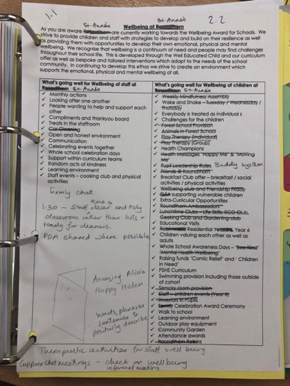
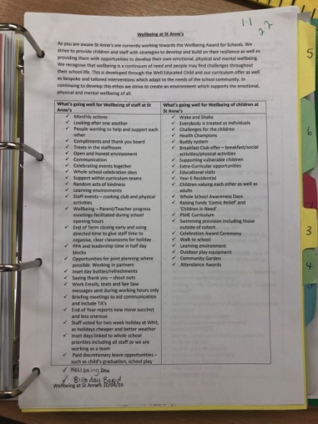

Slide 8
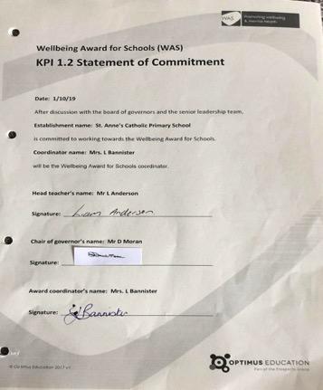
1.2 - A statement of commitment is signed and stored in the portfolio of evidence

Slide 9
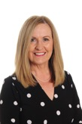
1.3 A change team is nominated and appointed.
11th April 2019- A change team was appointed that consists of Senior Leadership, Learning Mentor, Teachers, Teaching Assistants and a Governor.

Slide 10
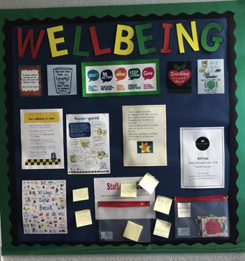
1.7 The whole-school community and other partners are informed about the award.
As well as being in :
Parent newsletter 10th April 19
Having a Staff Inset 11th April 19 - see 1.1
We also have a Wellbeing Display Board in our Staff room.
We constantly send messages to our whole school community
about well being from our APP and also through our twitter feed
search for #sacpskwb or #sacpskwellbeing

Slide 11
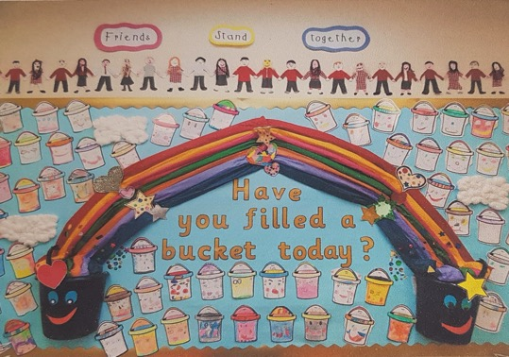
Objective 2
The school has a clear vision and strategy for promoting and protecting emotional wellbeing and mental health, which is communicated to all involved with the school.
Notes:
Objective 2-

Slide 12
2.1 A vision statement is in place that puts emotional wellbeing and mental health at the heart of the school’s aspirations
In St. Anne’s Catholic Primary School , we strive to achieve our vision strategy by following the five steps to wellbeing. We encourage children to build connections with their peers, families, neighbours and their local community- as well as encouraging them to build and invest by providing opportunities to develop those links and relationships.
We are a very active school. We do the daily mile, lots of PE, we have sports interventions as well as after school running and dance clubs. Our children understand the importance of keeping very active and how this impacts our wellbeing/
As a catholic school, we pride ourselves on giving to others- whether that be to the wider community or within school. We celebrate other faiths, we fundraise and support many charities, we ensure children know the importance of doing something nice for a friend or somebody in need.
At St. Anne’s Catholic Primary School, we find every opportunity possible to celebrate the awe and wonder of the world. We create opportunities in the curriculum or through our collective worships to take notice, to express our curiosities, to breathe in the beautiful and to take notice of the wonder of what we have been given. And finally, we ensure the children know the importance of continuing to learn. We challenge children and enjoy watching them succeed. Our staff are wonderful role models for this.

Slide 14
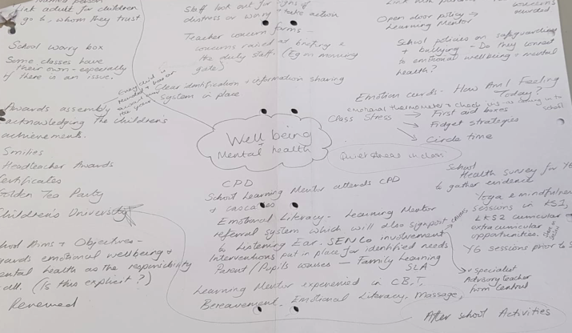
2.2 The school has reviewed its provision and understands how it currently supports emotional wellbeing and mental health, and where strengths, gaps or weaknesses in provision exist.

Slide 15
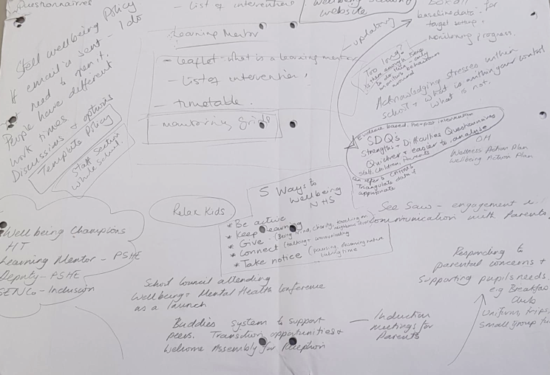

Slide 16
2.3 All relevant school policies (bullying, safeguarding etc.) have been audited to ensure they connect with the school’s work on emotional wellbeing and mental health.
Please see policy links that refer to wellbeing and care in our school community.
http://stannesprimaryknowsley.co.uk/wp-content/uploads/2020/04/13.1-SEN-Policy-19-20.pdf
http://stannesprimaryknowsley.co.uk/wp-content/uploads/2020/07/Relationships-and-Behaviour-Policy-July-2020.pdf
http://stannesprimaryknowsley.co.uk/wp-content/uploads/2012/10/FIRST-AID-POLICY.pdf
http://stannesprimaryknowsley.co.uk/wp-content/uploads/2012/10/INTIMATE-CARE-POLICY.pdf
http://stannesprimaryknowsley.co.uk/wp-content/uploads/2020/01/Child-Protection-Policy-Sept-2019.pdf
http://stannesprimaryknowsley.co.uk/wp-content/uploads/2020/07/Wellbeing-Policy-2020.pdf

Slide 17
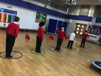
2.5 A strategy for emotional wellbeing and mental health, which takes into account all reviews and audits and addresses any gaps in provision, is approved and in place.
Our change team will continue with all members looking out for Staff training/cpd. Our DHT identified Simon Bolger (That Wellbeing Guy) for an end of year Inset Day. DHT and member of WB team also had CPD 1st May with Anne Johnson Knowsley First. DHT had online training with Simon Bolger 6th July. Another member of WB team (NM) signed up for wellbeing training online through Hays.
Yoga (children+staff), meditation, mindfulness has been taking place throughout the year and has had
an even bigger focus since the start of ‘Lockdown’. This will still be a big focus through
the summer and in the Autumn term 20. See 4.1
Mindful minute throughout the school day. Emotional check in. See 2.6.
After reviewing provision these extra regular activities were implemented in school
Notes:
Objective 2- Sara

Slide 18
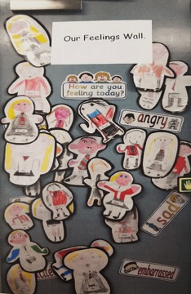
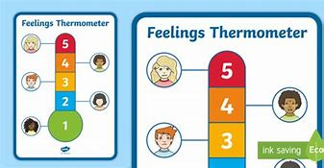
2.4 The school has reviewed and understands all the relevant risk factors that can impact on emotional wellbeing and mental health in pupils.
An example of a feelings wall that can be found in school….
Emotional Check In
We use a ‘Feelings Thermometer’ in each class, which allows the children to communicate how they are feeling. Children are given the opportunity to speak to an adult about what may be making them feel a certain way… we then act upon that as a school in many ways.

Slide 19
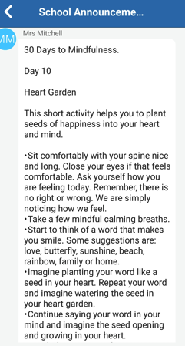
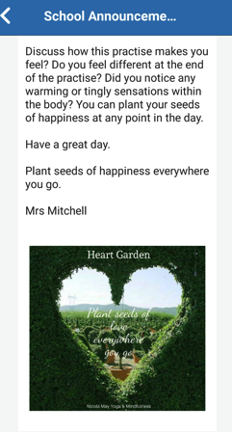
2.5 - A strategy for emotional wellbeing and mental health, which takes into account all reviews and audits and addresses any gaps in provision, is approved and in place.
Each morning we add a mindfulness activity to seesaw for all our children to complete. This is a perfect start to the school day….These activities can be completed by children and their families. This was started during COVID -1 9 after some suggestions how to improve our learning at home.

Slide 20
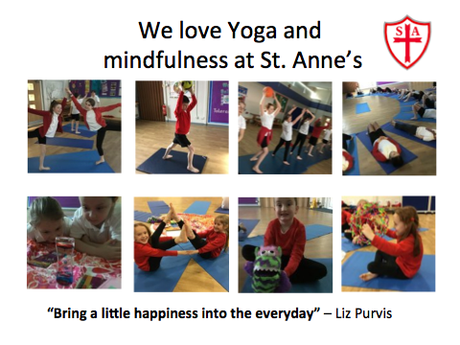
In St. Anne’s, we love yoga and mindfulness.
We actively use the ‘mindful minute’ before lessons start. This allows children to collect themselves and regain focus.

Slide 21
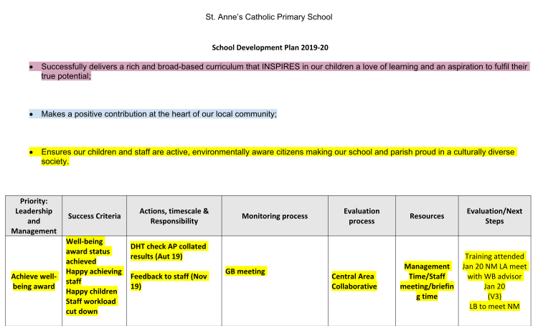
Our School Development Plan making reference to wellbeing

Slide 22
School Evaluation Form- September 2019
Through our curriculum, ethos and behaviour policy, house captains, council and prefect/buddy system our pupils believe strongly
that they have a voice and their opinions will be listened and responded to. They feel part of our school community and therefore
want to make a positive contribution to the life of the school. Through a focus in PSHCE, RSE, CW and RE on developing self-
awareness and interpersonal skills pupils behave well and are increasingly more mature, sensible and supportive to each other. We
continue to develop pupils who are: happy, confident and respectful. When children leave our school we aim for them to be
independent, active and environmentally aware citizens. We actively celebrate diversity, highlighting our wider community
through assemblies, display and specific focused activities (e.g theme weeks Rugby World Cup, Neuro Diversity Week, Other faith
Weeks, Kindness Week, Active Well-Being Week). Our children attend various outdoor pursuits centres (residential) that build
resilience, teamwork and character. This underpins the whole school approach to promoting resilience through praising efforts and
aiming high to challenge pupils of all ability levels. We regularly make positive contributions in our community as a school (visits to
homes, singing on special occasions, local nature walks).

Slide 23
School Evaluation Form- September 2019
Fundamental British (World) values
Through our programme of assemblies/focuses throughout the year, pupils are introduced to a set of values (St Anne’s Catholic
Primary School Child Focus) that we believe all children need to become effective and responsible members of our society. We had
a Visit from Kal for Sikhism week and this in conjunction with other trips and discussions has provided pupils with opportunities to
understand a wide range of different cultures and this has intensified their appreciation of the diversity of modern Britain and
made them more sensitive and aware of the need to celebrate differences and shared values. As a result, pupils have a good
understanding of the need for tolerance and respect. (Everyman/Playhouse Chinese New Year Workshop + Irish Immigration to
Liverpool during the Victorian Era). We also have linked every class in the school to a country to improve knowledge and be aware
of the different cultures across the world.

Slide 24
School Evaluation Form- September 2019
Healthy living
As well as promoting this daily, we have themed weeks throughout the year which promote this, in which we have cross curricular
links to focus on common themes. Over the years we have focused on healthy living and linked all our subjects towards this. We
invited different providers into school to promote different sports and encourage a healthy lifestyle. We regularly invite parents
and children to join staff on focused parkruns (adult 5k children’s 3K). We provide a wide range of sports in school and as many
extra - curricular clubs and taster sessions to cater for all interests to promote a healthy active lifestyle (see PE breakdown reports
on our website). The constant right choices are talked about regularly in class and whole school assemblies to promote healthy
living. During theme week science and DT are planned around the healthy week with a healthy focus.
Through our curriculum, ethos and positive behaviour management policy, pupils believe strongly that they have a voice and their
opinions will be listened and responded to. They feel part of our school community and therefore want to make a positive
contribution to the life of the school. Through a focus on PSHE on developing self-awareness and interpersonal skills, pupils behave
with integrity and are increasingly more mature, sensible and supportive to each other.

Slide 25
As a school we constantly reinforce the need for living healthy and how to keep mentally and physically healthy. We also teach age-
appropriate relationship and sex education. We employ a Learning Mentor who works extremely closely with vulnerable children
and their families; listening to their problems and providing practical solutions to these problems and building close links with a
range of other agencies. These include: Social Care, Police, CAMHS (Mental Health Team), Sure Start and the Educational
Psychologist, resulting in children and their families having the appropriate support at a time when they have major worries and
concerns. In addition to our PE curriculum, all pupils are encouraged to be physically active by walking/jogging and running a ‘Daily
Mile’ and through taking part in the broad range of extra-curricular sporting and physical activities on offer. As a result, pupils are
well supported pastorally. They know how to eat healthily, maintain an active lifestyle and keep physically and mentally healthy.
They have an age-appropriate understanding of healthy relationships through our ‘Journey in Love (RSE programme)’. More
recently we have been trying to encourage our children to walk to school with an emphasis on (Wednesday) WOW which is also
aimed at reducing traffic outside our school.
We continue to develop our pupils to be: happy, confident and respectful who contribute positively to their community. We
actively celebrate diversity, highlighting the diverse culture of our world through assemblies, display and specific focused activities
(e.g theme weeks RWC). We work with outside providers to build resilience, team work and character. This underpins the whole
school approach to promoting resilience through praising efforts and aiming to challenge pupils of all ability levels.

Slide 26
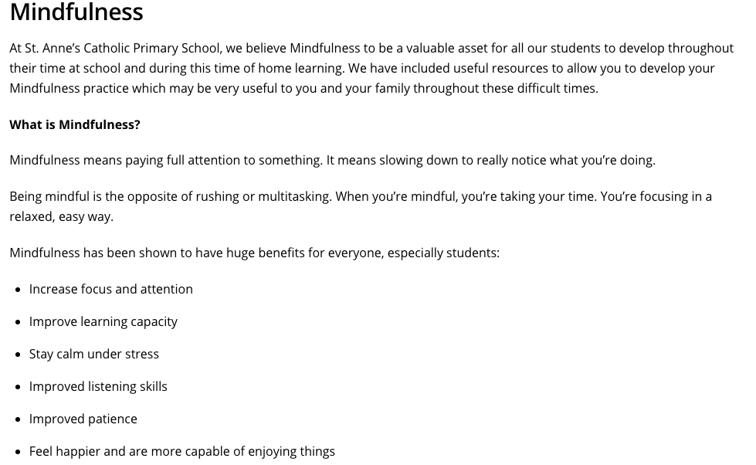
We have also provided lots of numbers for mindfulness activities including
charities that people can access for support.

Slide 27
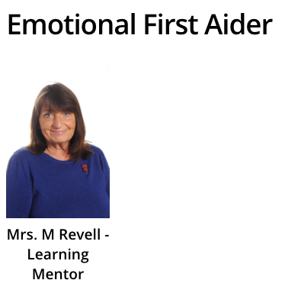
Mrs Revell our Learning Mentor is also our emotional first aider...
On our website, we have uploaded mindfulness resources for the children and families to access at different times throughtout the year.

Slide 28
2.6 The strategy and vision statement are communicated to the whole-school community.
Our website is constantly updated and there is a whole section on well being: http://stannesprimaryknowsley.co.uk/wellbeing/
Our Parent App sends regular updates to our families about well being and what we are doing as a school, however we felt people did not engage so we have used other avenues.
In our school newsletter we have a focus on well being. This happens weekly giving tips, techniques and general advice.
We communicate our vision and strategy to parents, staff and pupils - this is constantly highlighted through our twitter feed, our school app and ‘Seesaw’. A search of our twitter feed through #sacpskwb or #sacpskwellbeing will provide ongoing evidence about what we do as a school.
A copy of a recent newsletter is in a documentation email. Check newsletters on our website.

Slide 29
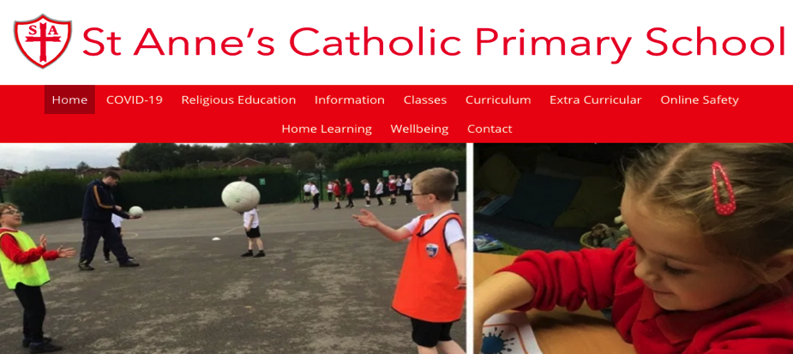
Our school website is a great platform for communication and is updated regularly.

Slide 30
We send out a weekly newsletter to families...
We use the seesaw app to communicate with families and celebrate their child’s work
We have parish newsletters that we share...

Slide 31
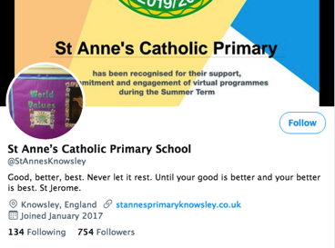
We use parentapp to communicate with the families...
We are very active as a school community on twitter...

Slide 32
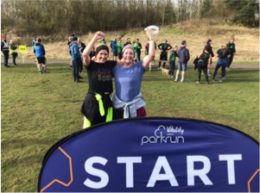
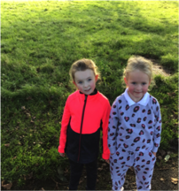
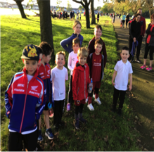
Our school staff, families and former pupils enjoy coming together to take part in this weekly, positive and welcoming local event helping to enhance their health and happiness in the great outdoors.

Slide 33
2.7 EVALUATION: The SLT has identified a clear set of outcomes for measuring the impact of the strategy and progress towards them is monitored and appropriate follow-up action is taken.
Our strategy is to incorporate the five steps to wellbeing into every school day life and to involve the whole community:
This is monitored weekly through observations and feedback to other stakeholders through our weekly newsletter or from app feedback - see documentation from email
Monitoring is constant and discussed regularly with key members of staff liaising (key members are constantly visual in school to children and adults). Acting upon feedback and putting extra measures in place: Yoga club (for selected children), running club, mindfulness,
Evidence in our newsletters, staff 1:1s, APP,

Slide 34
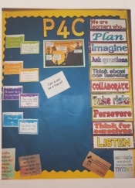
Objective 3
The school has a positive culture which regards emotional wellbeing and mental health as the responsibility of all.
3.1 The school takes steps to create an awareness across the whole school community of the importance of emotional wellbeing and mental health, including its impact on academic performance.
Wellbeing section on website
...School Displays
We promote mental health in school through our 5 steps to wellbeing. We have weekly challenges which forcus on being active
Attendance at workshops...

Slide 35
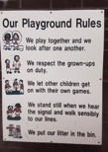
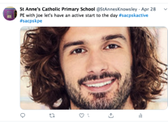
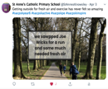
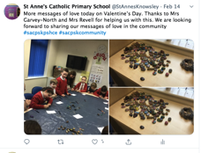
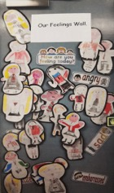
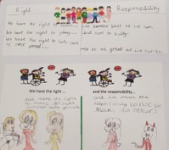
3.2 The whole-school community has contributed to the vision and strategy for emotional wellbeing and mental health.
During lockdown the families and school have been enjoying the Joe wicks routine every morning
Please also see 4.1 for further evidence of this.
We have a buddy system in school with UKS2 pupils supporting KS1 pupils with behavioural and emotional support.
Promoting wellbeing throughout lockdown, by encouraging lots of time outdoors as a family where possible.
Children and staff have a good awareness of what wellbeing involves within our school. Promoting the happiness and wellbeing of all around us, including ourselves.
The children promoted positive messages using painted pebbles around the community.

Slide 36
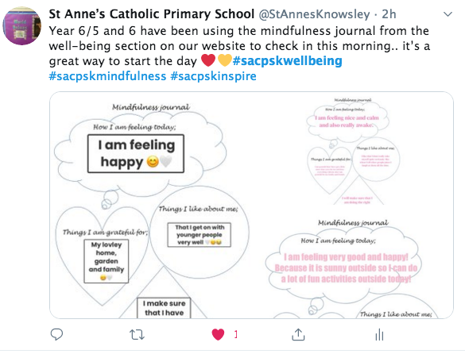
We use mindfulness journals to promote and reflect on our own feelings and emotions.
Nicola Mitchell is a qualified yoga and mindfulness/meditation teacher for both adults and children. Her knowledge and expertise are drawn upon and used widely in our school.

Slide 37
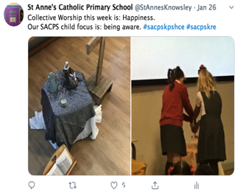
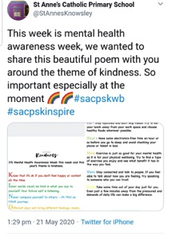
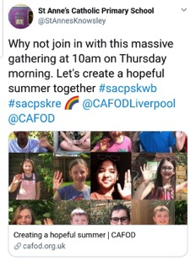
Promoting well-being through our collective worships.
Using our social media links to promote wellbeing for all.
CAFOD links promoting wellbeing within school and the wider community

Slide 38
3.3 The whole-school community understands their role in promoting and protecting emotional wellbeing and mental health.
These are some of the strategies that we provide as a school:
A Named adult as a ‘go to’ for children
Restorative practice for all staff 1-1 with Maureen (Learning Mentor)
Open door policy for children with our Learning Mentor
We have a Wellbeing thermometer - Emotional check in at register.
NSPCC posters/training/leaflets are on display throughout the school Childline contact number.
Wellbeing info & resources on newsletter and website.http://stannesprimaryknowsley.co.uk/wellbeing/resources-for-wellbeing/ these are also posted via twitter
PSHE included in a school weekly focus highlighted in two school gatherings and also in our newsletter. It is also highlighted on our staff google calendar
Mindfulness - Wellbeing advice and recommendations on website - for family and staff http://stannesprimaryknowsley.co.uk/wellbeing/resources-for-wellbeing/
Model good behaviour from everyone at school (see behaviour policy)
Transition support each year from class to the next class or across Key Stages
Circle Time takes place within school to discuss certain issues
A big drive as a school to promote physical activity with the daily mile and getting active #activebodyactivemind
Please see the behaviour and relationship policy.
Notes:
Objective 3- Maureen

Slide 39
3.4 An accountability framework clearly sets out who is responsible for emotional wellbeing and mental health within the school leadership.
Please see the section of our school website. As a school we are also encouraged to look out for each other and discuss issues with any of SLT or a close colleague
http://stannesprimaryknowsley.co.uk/wp-content/uploads/2020/07/Wellbeing-Policy-2020.pdf
Please see accountability framework.

Slide 40
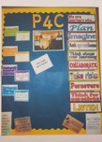
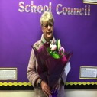
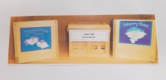
3.5 The school works to implement positive ways of talking about, and removing the stigma around, mental health.
As a school there are many ways we promote talking about Mental Health:
Growth mindset display - Inspirational and positive posters around school. Daily affirmations. Relax Kids.
Regular Interventions with our Learning Mentor.
Regular Yoga and mindfulness sessions with: children, staff and online.
We always have focus weeks like: PSHE - Mental Health Awareness Week and Neuro Diversity Week, celebrating difference, Black Lives Matter, Kindness Week
We provide emotional support for our children, staff and families through listening to all and signposting to other agencies.
Daily emotional check in with staff and children.
Calm Box - Time out area.
Our quiet Reflection area and Collective Worship Areas in class & outside.
Neurodiversity week- led by SENCO (autism, dyslexia etc. were covered)
Continually addressing diversity- see diversity booklet on documentation email.
Displays around school and in classrooms...
An example of some of our Mindful minute sessions
...Valuing our dedicated staff
Our worry box and suggestions box in the school foyer.

Slide 41
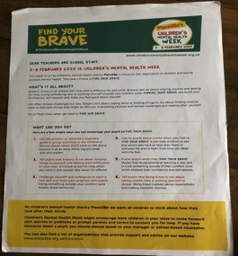
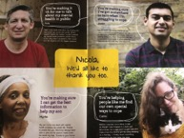
Occupational Health - see objective 4.2
How are we encouraged to talk about feelings? Children in KS1 enjoyed weekly
mindfulness sessions. The children were actively encouraged to discuss feelings
and emotions.
We have regular charity events raising money for Mind Charity. We have Mind posters
in the staff room with lots of tips, resources and contact
numbers.
A whole school approach to Mental Health Awareness Week.

Slide 42
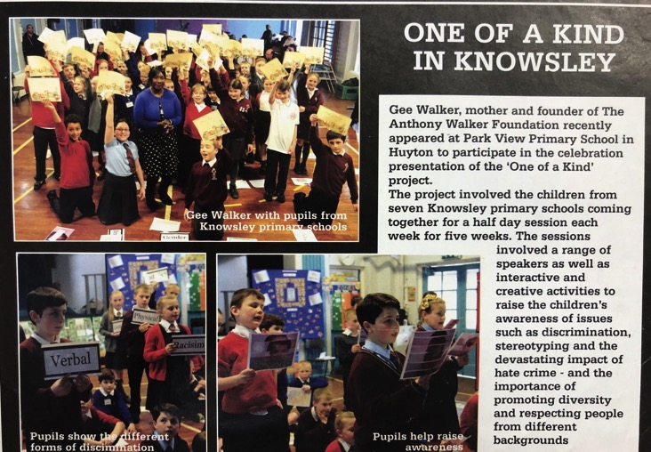
One of a Kind Project.
A local project involving 7 schools coming together for weekly sessions to raise awareness of issues such as discrimination, stereotyping and the devastating impacts of hate crime.
Promoting diversity and respect for people from different backgrounds.

Slide 44
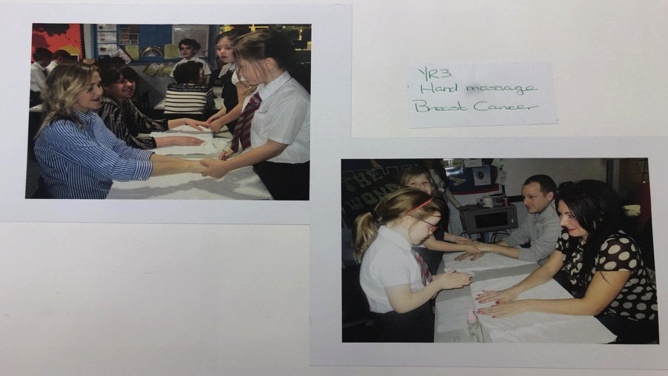
Our parents were invited into a classroom spa to raise awareness and funds for Breast Cancer.

Slide 45
Objective 4
The school actively promotes staff emotional wellbeing and mental health.
4.1 Staff emotional wellbeing and mental health is specifically included in the strategy.
Staff Yoga - in school & at home during lockdown
Shout out Board
Wellbeing Display
Take what you need - affirmations.
Thank you emails/cards/feedback
You’ve been mugged
Wellbeing Fairy
Thank you texts/email.
Notes:
Objective 4- Nicky

Slide 46
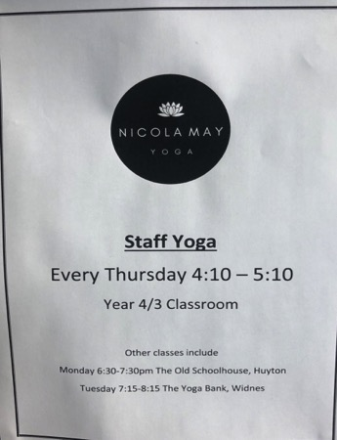
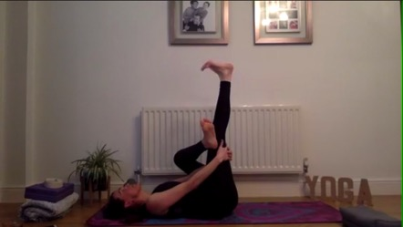
Yoga in school for staff has been available each week since September 2019.
Online classes have been available for all staff during lockdown.

Slide 47
During lockdown teachers and staff have made weekly wellbeing calls to families at home. Staff have also had regular whole class zoom calls.
Our HT and SENCo have regularly liaised with children on EHCPs and with children considered as vulnerable.
Emails have been scheduled to arrive in working hours. Phone calls made during working hours where possible. Staff are encouraged to engage with Seesaw during working hours only.
Staff meeting - If a staff meeting is not appropriate for all staff, there is no pressure to attend. There is also a time limit on staff meetings.

Slide 48
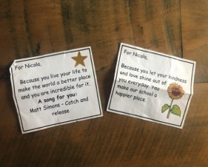
Friday night quiz for all staff via Zoom during lock down.
Regular anonymous visits from the Wellbeing/chocolate fairy.
A virtual staff room during lock down. A chance for staff to take a break & catch up with colleagues.

Slide 49
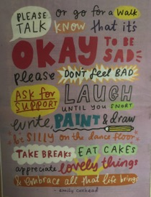
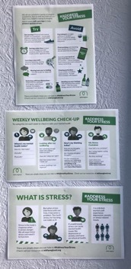
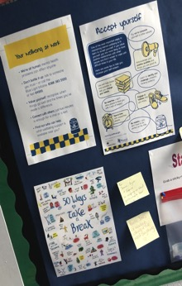
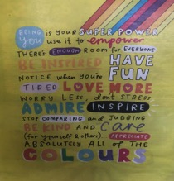
Staff Wellbeing board in our staff room.
Positive affirmations - Take what you need.
Positive quotes.
Shout out
Useful tips regarding wellbeing and contacts also on our website.

Slide 50
4.2 A budget is in place and resources allocated for staff emotional wellbeing and mental health.
The following funds are available for necessary training/resources to support staff emotional wellbeing and mental health.
School Improvement fund linked to CPD for mindulness
Staff Development fund
Service Level Agreement
With effect from September 2020 all staff will benefit from having a Staff Absence Insurance Policy in place. This will provide a confidential support mechanism to support the emotional and mental health of staff. This policy has been put in place as part of our ongoing commitment to improving and supporting the wellbeing of our staff

Slide 51
4.3 Stress management, positive wellbeing interventions and reward systems are in place for staff.
Lunch provided on Inset days for all staff and staff are encouraged to enjoy their lunch together as team
Occupational support - See 4.2
During lockdown, members of the SLT made wellbeing calls to staff.
Please see policy links listed in 2.6 which includes policies that
relate to the health and wellbeing of our staff.
During ‘lockdown’, staff were given the opportunity to attend an online Zoom Wellbeing course called ‘Address the Stress’ to enable them to understand, recognise the signs of stress and support themselves and others.

Slide 52
4.4 The staff appraisal system, alongside ongoing supervision, ensures emotional wellbeing and mental health is recognised and monitored.
At St. Anne’s Catholic Primary School we have an open door policy. All staff are encouraged to talk to anyone they feel comfortable talking to whether that is a member of SLT or another colleague. Staff are encouraged to talk to others and seek support, guidance or advice where necessary.
Template from appraisal system - Please see attached document in email.
Informal support - Wellbeing document - Please refer to staff and family wellbeing advice and resources in documentation email.
Emotional support - Statement off anonymous staff member in documentation email.
Thank you flowers
Flowers for special birthdays, new baby or when leaving St. Annes.
1-1 meeting with HT (new and existing staff) - Regular catch up meeting to check everyone is happy. Survey Monkey surveys
Buddies/NQT mentor new staff members.

Slide 53
Staff appreciation- Flowers are given as a thank you for staff’s hard work.
A staff treat- fruit in the staffroom!
Celebrating our healthy school status!

Slide 54
4.5 EVALUATION: Feedback is gathered from staff about the quality of support in place for their emotional wellbeing and mental health, and appropriate follow-up action is taken.
Survey Monkey COVID and highlighting what we do well and areas for development
One to ones meeting between HT and all staff members. Checking in on how they are, how the year is going, whether they are happy etc.
Wellbeing calls to all staff - Checking in on their wellbeing and
asking if they need some support.
End of year staff Survey Monkey

Slide 55
Objective 5
The school prioritises professional learning and staff development on emotional wellbeing and mental health.
5.1 Professional learning and staff development forms part of the strategy, including consideration of resource allocation.
All of the staff at St Anne’s are invited to take part in ‘Wellbeing First Training’ which is an online course.
Our learning mentor, Maureen Revell, is also a Mental Health First Aider and this training has been cascaded to staff in staff meetings and online over lockdown. Our staff are able to identify signs of anxiety and issues with mental health, both in themselves and our children. We have a clear reporting system to refer children to get additional help should we feel that they it. All members of staff are aware of these procedures and how to follow them.

Slide 56
5.2 The school is aware of current confidence and capacity among staff in promoting emotional wellbeing and mental health, and training needs are identified.
Our staff skills audit allows us to identify any training needs for staff members and these are acted on to ensure all staff have the capacity to promote emotional wellbeing and mental health. We feel as a staff, that we are confident in identifying and addressing what we need to do to ensure the children get the appropriate help via a referral process if needed.
See staff evaluation stakeholder forms.

Slide 57
5.3 The school has a targeted short-term and long-term CPD programme in place that includes emotional wellbeing and mental health, with training opportunities offered.
The school has both long term and short term plans in place to ensure that staff are regularly updated on training needs.
Our staff have completed the following training and will continue to complete these courses on a long term cycle, as they are refreshed:
Safeguarding Training
Child Protection Training
Mental Health First Aid
Cascade Training
Nicola Mitchell, a member of the Wellbeing Team and Teaching Assistant in school, is currently completing a diploma in Supporting Mental Health in Children & Young People

Slide 58
5.4 A programme of mental health awareness training is available to all staff.
Weekly opportunities to sign up for courses through Knowsley First (March 20)
Staff training available online via Hays.
Address the Stress course attended by staff.
Mental Health First Aid - Information cascaded to staff during staff inset by Learning Mentor.

Slide 59
5.5 EVALUATION: The school evaluates the extent to which all teaching staff feel they have the knowledge and skills to promote emotional wellbeing in their class teaching, and appropriate follow-up action is taken.
Our staff feel that they are well supported and have the knowledge and skills to promote emotional wellbeing at St Anne’s Catholic Primary School.
All staff know and follow the policies and the appropriate follow-up action is always taken.
Staff are regularly trained and have CPD to ensure they have the knowledge and skills to promote emotional wellbeing across our school and staff are aware of where they can go to access further training or support, should they feel to do so.
Survey Monkeys are completed about staff wellbeing (and knowledge) and they are evaluated and acted upon.

Slide 60
Objective 6
The school understands the different types of emotional and mental health needs across the school and has systems in place to respond appropriately.
6.1 Assessments of pupil and staff needs are conducted at regular points and feedback is acted upon.
SEN assessments are completed termly and data is analysed by Class Teachers and SENCo and next steps are identified and actions are put in place.
Planning and Review meetings are carried out termly. Concerns are added to the P & R list and discussed. Appropriate action is then decided in how we can best support the children moving forward.
Teachers are continually assessing both summatively and formatively and concerns are documented and acted upon with the support of SLT.
If a member of staff has been absent for a period of time, a return to work interview is conducted. As a staff, we always feel fully supported in this process. Survey monkeys are also completed to gain feedback about staff’s thoughts and feelings.
Parents and pupils surveys are conducted routinely and feedback is evaluated. We are continually striving to ensure we are doing all we can to support the emotional needs as well as the academic needs of our pupils. Parent survey is attached to the document email we have sent.

Slide 61
6.3 There is a clear identification and information sharing system for pupils.
In our school, we have an open door policy- particularly for children who want to speak to our Learning Mentor. Mrs Revell is always available to speak to the children if they are needing support.
Alternatively children also have a designated adult they can speak to, this is an adult that they have personally chosen.
In the foyer area, there is a worry box that children can add to. The worry box
is regularly emptied and any worries/concerns in there
are acted upon immediately.
For our younger children, we have a worry monster!

Slide 62
On the playground we have a ‘friendship stop’ where the children can go if they are feeling lonely or have nobody to play with. We ensure no children are ever left out or spend their free time feeling sad.
We have regular school council meetings where are councillors are wonderful advocates for their class. We also have house captains- we have plenty of ways in which children’s voices are heard and ideas are acted upon.
We know entering puberty can be very hard and we deal with this sensitively. We have a red box outside of Year 6 that children are aware of- this allows them to discreetly collect any sanitary products they may need.

Slide 63
Worry box and suggestion box that can be found in easy reach for the children. These are checked regularly and concerns/worries are dealt with immediately.
Playground application form for our buddies.

Slide 64
6.4 The school uses its best endeavours to provide for pupils a range of interventions appropriate to the needs identified.
In St. Anne’s Catholic Primary School we have a wide range of interventions being delivered to ensure we are meeting the specific needs of our children. Some of which include;
Yoga- for relaxation and mindfulness
Lego therapy- to encourage social skills
Interventions and support for children with dyspraxia
Speech and Language interventions which have been delivered from both outside agencies as well as a lead TA who cascaded this training to other TA’s and parents.
Strengthening of fine and gross motor skills
Sensory circuit
Maths and English Interventions
Chatty Kids- which encourages discussion
Social skills- to help our children who may struggle with social skills.
Nurture interventions
Bereavement 1:1 time with children who may have lost loved ones.
1:1 time given for pastoral care for children.

Slide 65
6.5 Arrangements with external specialist services are in place with clear referral pathways and outcomes agreed for pupils.
Our school makes referrals to the appropriate services directly using the relevant forms. We use The Needs Guidance to ascertain where the children fit in terms of levels of need. The appropriate agencies are liaised with including; CAMHS, children services, school nurse, family first, MASH team and operation encompass.

Slide 66
6.6 The school provides signposts to appropriate online information, services and support.
As a school, we have worked hard to ensure that we offer the appropriate support and signpost people to any relevant online information, services or support that they may need. We have a Wellbeing display in school that parents/staff and children can see. It provides lots of information and shows exactly who is part of our Wellbeing Team at St. Anne’s Catholic Primary School.
The wellbeing section of our website has lots of information for families ranging from mindfulness activities/workpacks to agencies phone numbers they may need for support.
Where families drop children off in the morning, there is a parent notice board that is continually updated with relevant information.
We have also ensured that we have childline posters in discrete places e.g. back of the toilet doors. We are confident children will be able to access this information without the worry or fear of being seen. Our staff and Learning Mentor are always available to support children and families and are able to signpost people to appropriate services when required.

Slide 67
This is Mrs Revell, our wonderful Learning Mentor. She offers unlimited support and guidance to children, families and staff!! Mrs Revell’s door is always open- she is always there to work closely with individuals who are struggling with social, emotional or behavioural problems that affect their ability to learn, attend or affecting their wellbeing.

Slide 68
Yoga takes place for children throughout the school day, staff after school and after school clubs for children in KS1 and KS2. . We thoroughly enjoy it!

Slide 69
6.7 EVALUATION: Evidence is gathered about the effectiveness of the support available for pupils’ emotional and mental health needs, and appropriate follow-up action is taken.
Staff concerns and parent concern forms are stored confidentially in the Headteacher’s office. Actions and next steps are annotated on and these are monitored to ensure next steps have been taken.
In Year 6, we complete a health and wellbeing survey electronically- a report is then generated and delivered to school. This is a great tool as even though it is data from Year 6, we know it draws our attention to issues that are likely to be felt throughout the school.
Pupil surveys and parent surveys are completed regularly and data from this is analysed and actions are taken to address issues.
Staff audits are completed, as well as online survey monkeys.
Staff also have 1:1 with the Headteacher or a member of SLT and this is an opportunity to discuss anything we feel is relevant with regards to our work or our wellbeing.

Slide 70
Objective 7
The school actively seeks the ongoing participation of the whole-school community in its approach to emotional wellbeing and mental health.
7.1 Pupil voice mechanisms are in place and used at regular points.
Please see pupil evaluation form on award place.
Notes:
Objective 7- Linda

Slide 72
7.3 The school has identified ‘Wellbeing Champions’ from across the whole-school community.
Wellbeing ambassadors were appointed in Spring Term 2020…. Due to Covid, wellbeing ambassadors have not been able to fulfil their roll, however they have been encouraged to communicate with their peers via our online learning platform.

Slide 73
7.4 The school proactively and regularly communicates with the whole-school community regarding wellbeing
See previous slides referring to whole school communication including;
#sacpskwb #sacpskwellebing on twitter
Wellbeing section of website
Seesaw
Our Newsletter (on our website)
School APP
Google calendar

Slide 75
Another example of wonderful work shared on Twitter using the hashtag sacpskwb.
This is focusing on Black Lives Matter and in particular the story of Rosa Parks.
We have a strong focus on diversity in our school.

Slide 76
Huyton Resource Centre
Children from KS2 visited and their reflections showed how much they benefited from the experience.

Slide 77
7.5 EVALUATION: The school monitors the extent to which the whole-school community feels engaged with the school’s approach to emotional wellbeing and mental health, and appropriate follow-up action is taken.
Email from a parent..
The children have used the mindfulness skills and yoga they learnt at school whilst at home.
We had a positive response to our 30 Days to Mindfulness Challenge throughout ‘lockdown.’ Please see parent complimentary email enclosed within documentation email.

Slide 78
We have used our seesaw app as a platform to share messages from our wellbeing ambassadors. This particular message was to share two songs with poignant lyrics so that class friends would not be worrying about changes returning to school.
These have been very well received and our families often leave lovely comments to thank our wellbeing ambassador.

Slide 79
Objective 8
The school works in partnerships with other schools, agencies and available specialist services to support emotional wellbeing and mental health.
8.1 The school has identified and maintained links with appropriate local health, social care and voluntary and community sector services.
Discussions with Learning Mentor for families who are struggling which may be identified by CT or other member of staff and referrals made: Social Services, MARF, MASH School Nurse, CAHMS, Early Help, Young People’s Mental Health Service, My Time, or signposting to our SENCO,
If parents/families are struggling our Learning Mentor researches who to help families with:
Emergency Services, Childline Signposting, Bully Busters, NSPCC.
We have also worked with outside agencies to build confidence : Chatty Therapy for Speech and language and a SEND Specialist school for Speech and Language were utilised to aid with children’s Speech and language.
Central Area Children meetings with children working together at different Anti- bullying diversity. We have provided additional support for children with EHCPs emotionally, buying specialist SEN support in and working with Educational Psychologists.

Slide 80
The Good Shepherd collection
St Anne’s Catholic Primary School fundraising for Willowbrook Hospice...

Slide 81
Our children worked with the local authority to help design a new play area at McGoldrick Park, Huyton. The children were invited to the grand opening with Bob The Builder.

Slide 82
Our choir enjoy visiting the residents of local care homes to share their beautiful singing voices.

Slide 84
The children worked with the local authority to raise awareness of road safety. They designed a road sign to improve safety and encourage drivers to slow down in the areas around our school.

Slide 85
St Anne’s choir singing at Huyton library for local residents
St Anne’s choir singing at a residential care home.
In school we use the Welcomm Speech and Language support service and baseline our children on entering reception. This enables us to give the best support for our children as soon as they begin school. Our Learning mentor uses Tamhs for 1:1 and small groups support specifically for mental health. Other external services such as Butterflies, CAMHS and Family First are used to support children from the age of 5 and up.
In school we have a sports coach, Michael Corless who supports the wellbeing of children through small group sport interventions. We also use other forms of sport to support the wellbeing of our children such as Gaelic Football and Rugby Coaching. We also have a school running club which has proven very popular this year. This is led by our Headteacher.- Liam Anderson.
Vicky Powell from the Local Authority, visits the school regularly and works with families and their children covering a vast array of topics, including supporting phonics, maths and craft based workshops i.e making story puppets. This supports and promotes wellbeing and builds good relationships with our wider school community.

Slide 86
8.2 The school has identified representatives who attend local mental health forums to share information and new learning.
...Small group interventions
Attendance by LM on
mental health forums
DHT meeting with families who need extra support
Yoga and mindfulness sessions take place every week with Nicola from our wellbeing team in school to support our children and staff.
...School council attends a mental health forum along with Sara Peters a member of our Wellbeing team.
Please see web page, where there is information for parents and carers…
http://stannesprimaryknowsley.co.uk/wellbeing/resources-for-wellbeing/
Please see additional support information attached on a seperate email for sharing new learning.

Slide 87
8.3 The school works with other schools to share best practice and new learning, establishing networks where appropriate.
ALPSIT - Archdiocese training - for school collaboratives (Catholic schools) Leaders and children
...Our school works in partnership with other local schools. One example of this is an annual Community Cohesion Conference for Anti-bullying..
Children attended a Mental Health Forum with our collaborative schools..
Share Knowsley - food banks
The Learning Mentor attends termly Network Meetings.
Orange group of CAH this year Mr Waine working with St Aidans, St Aloysius and Slyvester on Sport and promoting a child’s journey through school through exercise
KSSP Knowsley Schools Sports Partnership -
CAH cluster WB on the agenda
That wellbeing guy attended by DHT Well Being at schools July 2020
DHT attended addressing anxiety in children May 2020

Slide 88
8.4 The school informs and participates in local commissioning arrangements undertaken by the local authority and/or Clinical Commissioning Group.
Data shared with Local Authority and compared with other schools (attendance)
Surveys commissioned from LA an administered by the school nurse in school surveys linked to drugs mental health wellbeing and LA act upon his. Knowsley Children and Young People's Health and Well Being Survey.
Pass survey completed by children in Key Stage 2
Health surveys carried out with results fed back to parents
Knowsley CLC carry out surveys linked to internet safety well being
Our school works in many collaborations through the Central Area of Huyton collaboration of schools and also through the Archdiocese of Liverpool signposting and sharing good practice
Every year we have the NHS in for health and weight checks, teeth checks and sight. Reception screening tests

Slide 89
8.5 EVALUATION: The school evaluates feedback received from its partners regarding joint working, and appropriate follow-up action is taken.
Challenge partners Andrew Morley focus on improving reading across the school reading for enjoyment improving wellbeing - DEAR implemented
School Improvement Partner - Jane Holmes discussing with HT and Governing Body about the wellbeing award
CAH - support Julie Peach - training linked to Wellbeing award. Knowsley First CPD Zoom meetings through Lockdown period - fed back to staff
SLE - Marie Evans for EYFS - observing our children in our setting focus on: Managing Feelings and Behaviour, Self-Confidence + Self Awareness + Making Relationships - focus on personal social health education.
School Attendance Service used to help families who are struggling

